Slide 1
ITS Assignment
By : Muhammad Abdullah
Roll No. : 21
Lecturer : Sir Umer Hayat

Slide 2


The Internet of Things:
(A Connected Future)
Welcome to the world of the Internet of Things (IoT), where everyday objects are becoming increasingly connected and intelligent. The Internet of Things (IoT) refers to the network of physical objects ("things") that are embedded with sensors, software, and other technologies to connect and exchange data with other devices and systems over the internet.
by Muhammad Abdullah

Slide 3
IoT Devices and Applications
Smart Home
Wearable Technology
Industrial IoT
Connected Vehicles
From voice assistants to smart thermostats, IoT devices are revolutionizing how we live and manage our homes.
Smartwatches, fitness trackers, and health monitors are helping people track their fitness, health, and daily activities.
Sensors and data analytics are transforming manufacturing, agriculture, and energy, optimizing processes and increasing efficiency.
Autonomous driving, advanced driver assistance systems, and connected car features are enhancing safety and convenience.

Slide 4

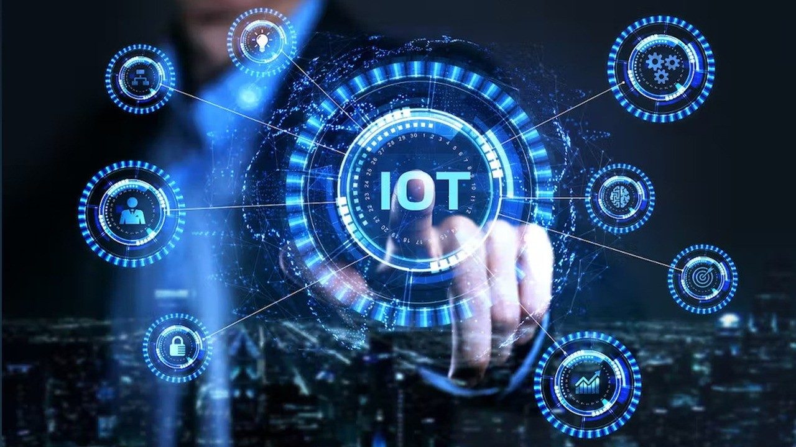
Benefits of IoT: Increased Efficiency and Connectivity
1
Data-Driven Insights
2
Automated Processes
IoT devices generate vast amounts of data, enabling businesses to gain valuable insights and make data-driven decisions.
IoT automation can streamline operations, reduce human error, and improve efficiency in various industries.
3
Enhanced Connectivity
4
Real-Time Monitoring
IoT connects people, devices, and systems, facilitating communication and collaboration across networks.
Real-time monitoring of assets, processes, and environments enables proactive maintenance and faster response to issues.

Slide 5
The Rise of the Internet of Things
1
Early Beginnings: The first connected devices emerged in the 1980s with the development of mobile phone networks.
2
The Rise of the Smartphone: The widespread adoption of smartphones in the 2000s paved the way for the development of mobile apps and connected devices.
3
Connectivity: The development of faster internet speeds and the availability of affordable sensors fueled the growth of IoT.
4
The Future of IoT: The continued development of 5G networks, artificial intelligence, and edge computing will shape the next wave of IoT innovations.

Slide 6

Challenges of IoT: Security and Privacy Concerns
Data Security
Privacy Concerns
Protecting sensitive data collected by IoT devices from cyberattacks and unauthorized access is paramount.
The collection and use of personal data by IoT devices raise ethical concerns and require robust privacy protections.

Slide 7
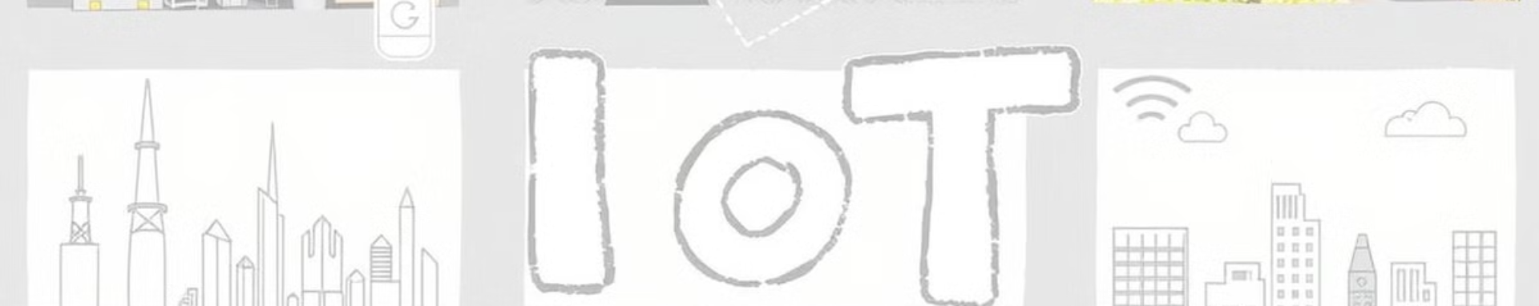




The Impact of IoT on Industries
Manufacturing
Healthcare
Agriculture
Smart Cities
IoT is transforming manufacturing processes, enabling real-time monitoring, predictive maintenance, and automated production lines.
IoT devices are improving patient care, enabling remote monitoring, personalized medicine, and telehealth solutions.
Smart sensors and data analytics are optimizing crop yields, water usage, and livestock management.
IoT is enabling intelligent traffic management, waste collection, public safety, and energy efficiency in urban environments.

Slide 8
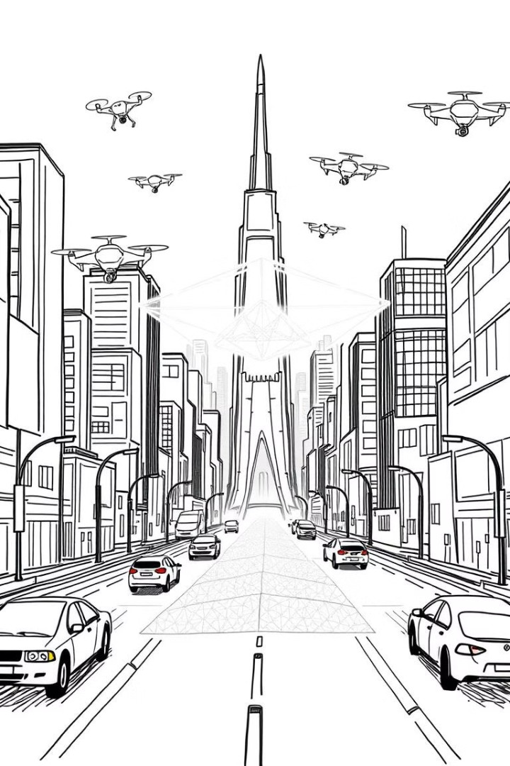




The Future of IoT: Trends and Predictions
5G Networks
Faster and more reliable 5G connectivity will enable more powerful and sophisticated IoT applications.
Edge Computing
Edge computing will bring data processing closer to IoT devices, reducing latency and enabling real-time decision-making.
Artificial Intelligence
AI-powered IoT devices will become more intelligent, able to learn from data, adapt to changing conditions, and make autonomous decisions.
Internet of Everything
The convergence of IoT with other technologies, such as blockchain and quantum computing, will create a truly interconnected world.

Slide 9





How to Prepare for the IoT Revolution
Understand the Basics
1
Familiarize yourself with the key concepts, benefits, and challenges of IoT.
2
Explore Applications
Identify relevant IoT applications in your field or industry and explore potential opportunities.
3
Develop Skills
Enhance your skills in data analysis, programming, and cybersecurity to thrive in the IoT era.
4
Stay Informed
Keep abreast of emerging trends, innovations, best practices in the rapidly
evolving field of IoT.
Embrace the Future
5
Be open to new opportunities and challenges, and actively participate in the ongoing IoT revolution.

Slide 10
Conclusion
Summary: The Internet of Things is transforming the way we live and work by connecting everyday objects and enabling automation. Despite challenges such as security and privacy , IoT presents vast opportunities across various sectors, from smart homes to industrial operations.
Final Thought: As technology continues to advance, IoT will become increasingly integral to our daily lives and future innovations.

